Slide 1

Polynomial topic distribution with topic modeling for generic labeling
Department of Software Engineering Faculty of Science and Information Technology Daffodil International University

Slide 2
Md.Rezwan Ul-Hassan Shadikur Rahman
151-35-917 151-35-988
Supervised by -
Ms. Syeda Sumbul Hossain
Lecturer
Department of Software Engineering

Slide 3
Outline
Terms
Motivation
Aims and Objectives
Research Questions
Research Methodology
Mapping Study
Research Experiment
Result Analysis
Contributions
Future Work

Slide 4
Terms
Data mining
Text mining
Polynomial distribution
Topic modeling
Generic labeling

Slide 5
Motivation
Why are we interested in it ?
Why should this be interesting to others?

Slide 6
Aim and Objectives
To present the topic modeling algorithms existing in the current-state-of-art.
Find out the effective number of topics, words and passes parameter for LDA training to best topic pulling out for obtaining the most effective result.
To figure out the most covering topics and label for polynomial topics.

Slide 7
Research Questions
RQ1: What are the topic modeling algorithms existing in the current-state-of-art?
RQ2: How to set the effective/ appropriate number of topics, words and passes parameter for LDA training for best topic pulling out to obtaining the most effective result?
RQ3: How to figure out the most covering topics and label for polynomial topics?

Slide 8
Research Methodology
Mapping Study for RQ1
Research experiment for RQ2 & RQ3

Slide 9
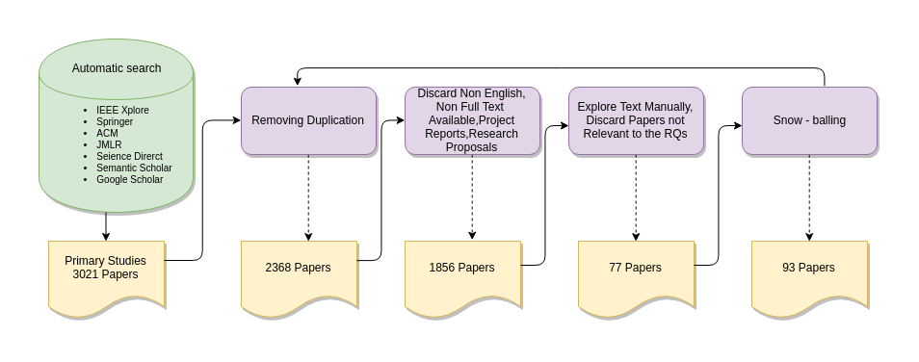
Mapping Study
Figure-1: Flow diagram of search and filtering procedure
Mapping study references-
https://github.com/Sourav-Hasan/topic-modeling-for-generic-labeling/blob/master/Mapping_Study_Result.xlsx

Slide 10
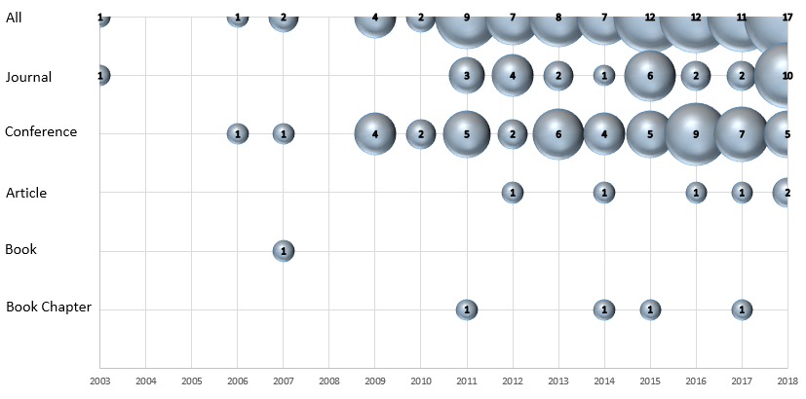
Mapping Study(Cont.)
Figure-2: Ordination of pertinent papers above time span each publication species

Slide 11
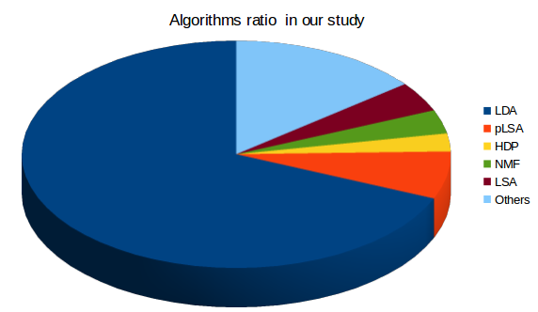
Mapping Study(Cont.)
LDA- 67%
pLSA- 7%
HDP- 3%
NMF- 4%
LSA- 5%
Others- 14%
Figure-3: Algorithms we have found in our study

Slide 12
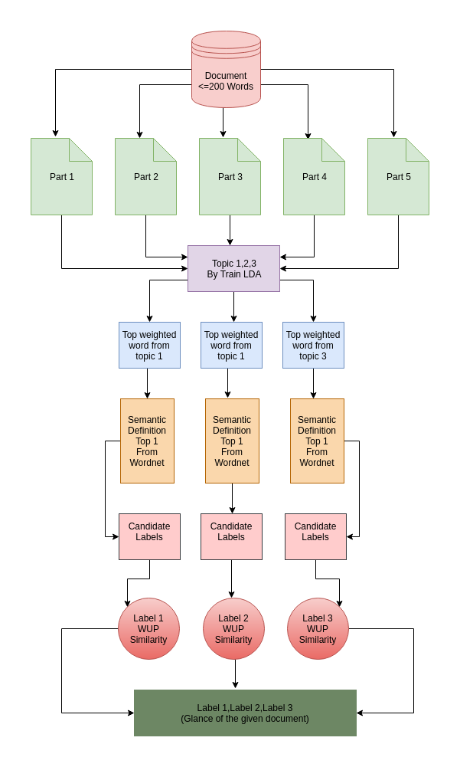
Research Experiment
Figure-4: Process of topic and label generation

Slide 13
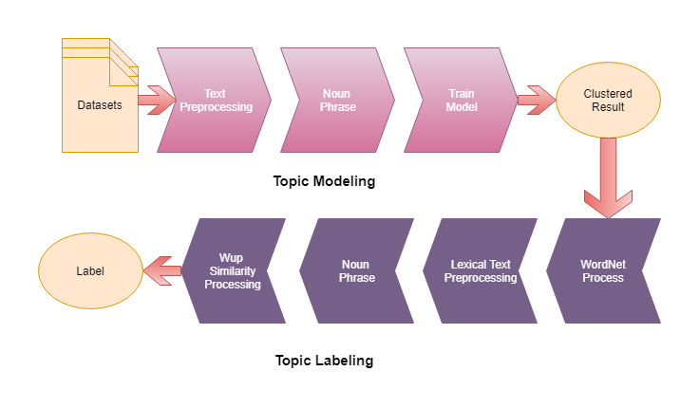
Research Experiment(Cont.)
Figure-5: Overview of our research process

Slide 14
Result Analysis Difference Between Taking Topic Quantity Four and Three
Table 1: Result of an example document with topic four
Topic 1 | love, yes, life
Topic 2 | ear, life, nonsmoker
Topic 3 | cigarette, brush, change
Topic 4 | life, year, yes
Table 2: Result of an example document with topic three
Topic 1 | love, yes
Topic 2 | life, year
Topic 3 | cigarette, brush

Slide 15
Result Analysis(Cont.) A sample dataset-
Traffic jam means a long line of vehicles that can not move or that can move very slowly. It is a common affair in the big cities of our country. There are many causes of traffic jam. Rapid growth of population and the increasing amount of vehicles are the main causes of it. Vehicles are much more than the roads can accommodate. The indiscriminate playing of rickshaw is another causes of it. Haphazard parking of vehicles alongside the pavement also causes of it. Violation of traffic rules is also responsible for it. The drivers do not follow traffic rules. Traffic jam causes untold sufferings to people. Sometimes it raises our mental tension. It causes loss of our valuable time. We have to wait to reach our destination. The students, the office-going people, the businessmen and the patients in the ambulance are the worst sufferers of it. Traffic jam can be removed by enforcing traffic jam strictly. The narrow roads should be broadened. By pass roads should be constructed in the big towns. One way movement of vehicles and building of fly over can solve this problem. We can reduce it by raising public awareness.
Our experimental five datasets link-
https://github.com/Sourav-Hasan/topic-modeling-for-generic-labeling/tree/master/datasets

Slide 16
Result Analysis(Cont.)
Table-3: Output for given dataset
Topics | Topic Words | Top Weighted Word | Candidate Labels | Label
Topic 1 | road, jam | road | way, travel, transportation | transportation
Topic 2 | traffic, rule | traffic | aggregation, thing, vehicle, locality, period, time | aggregation
Topic 3 | vehicle, cause | vehicle | conveyance, transport, people | transport
Output table for our experimental 5 documents

Slide 17
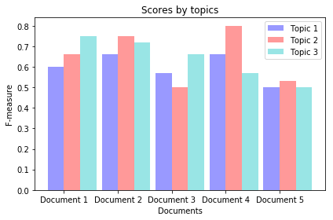
Result Analysis(Cont.)
Figure-6: F-measure score for topics of selected five documents

Slide 18
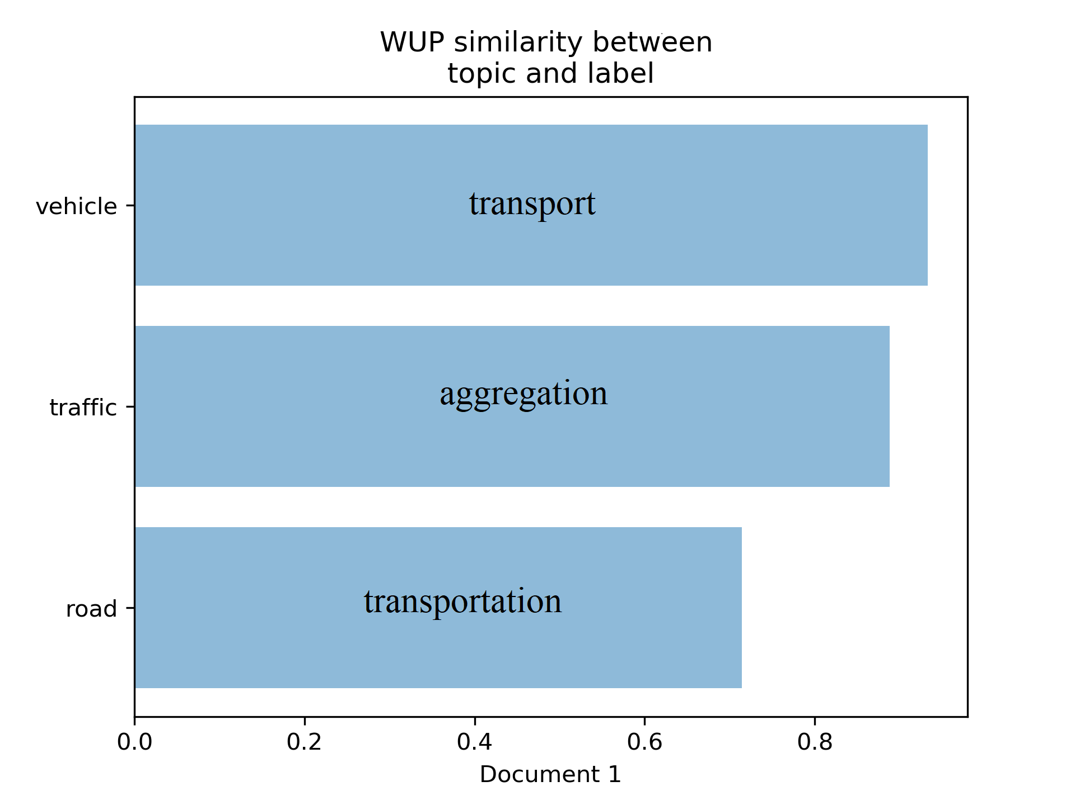
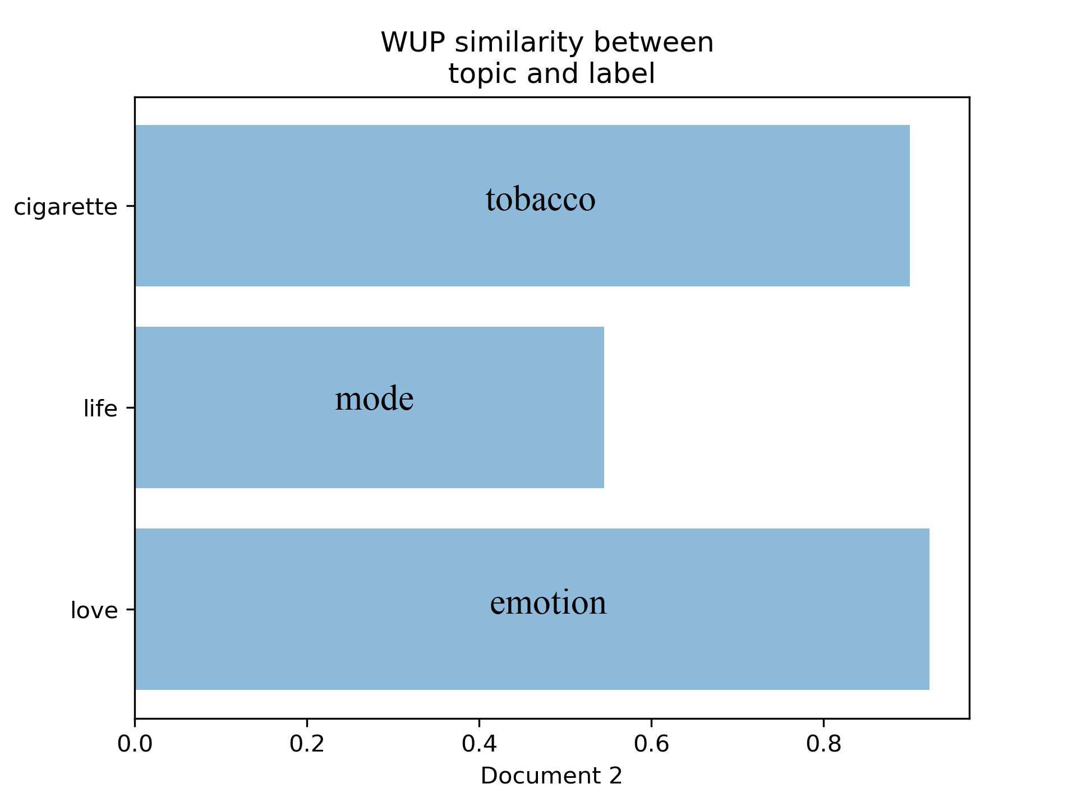
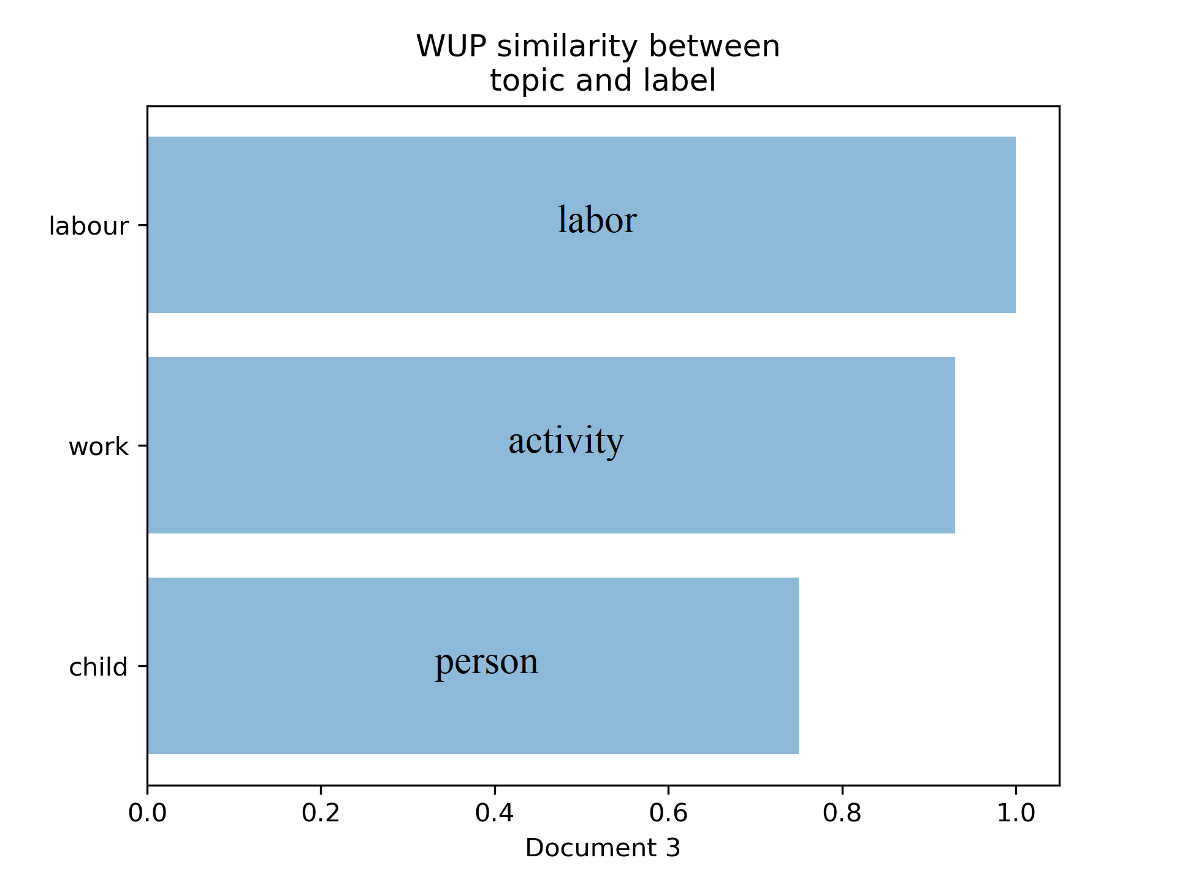
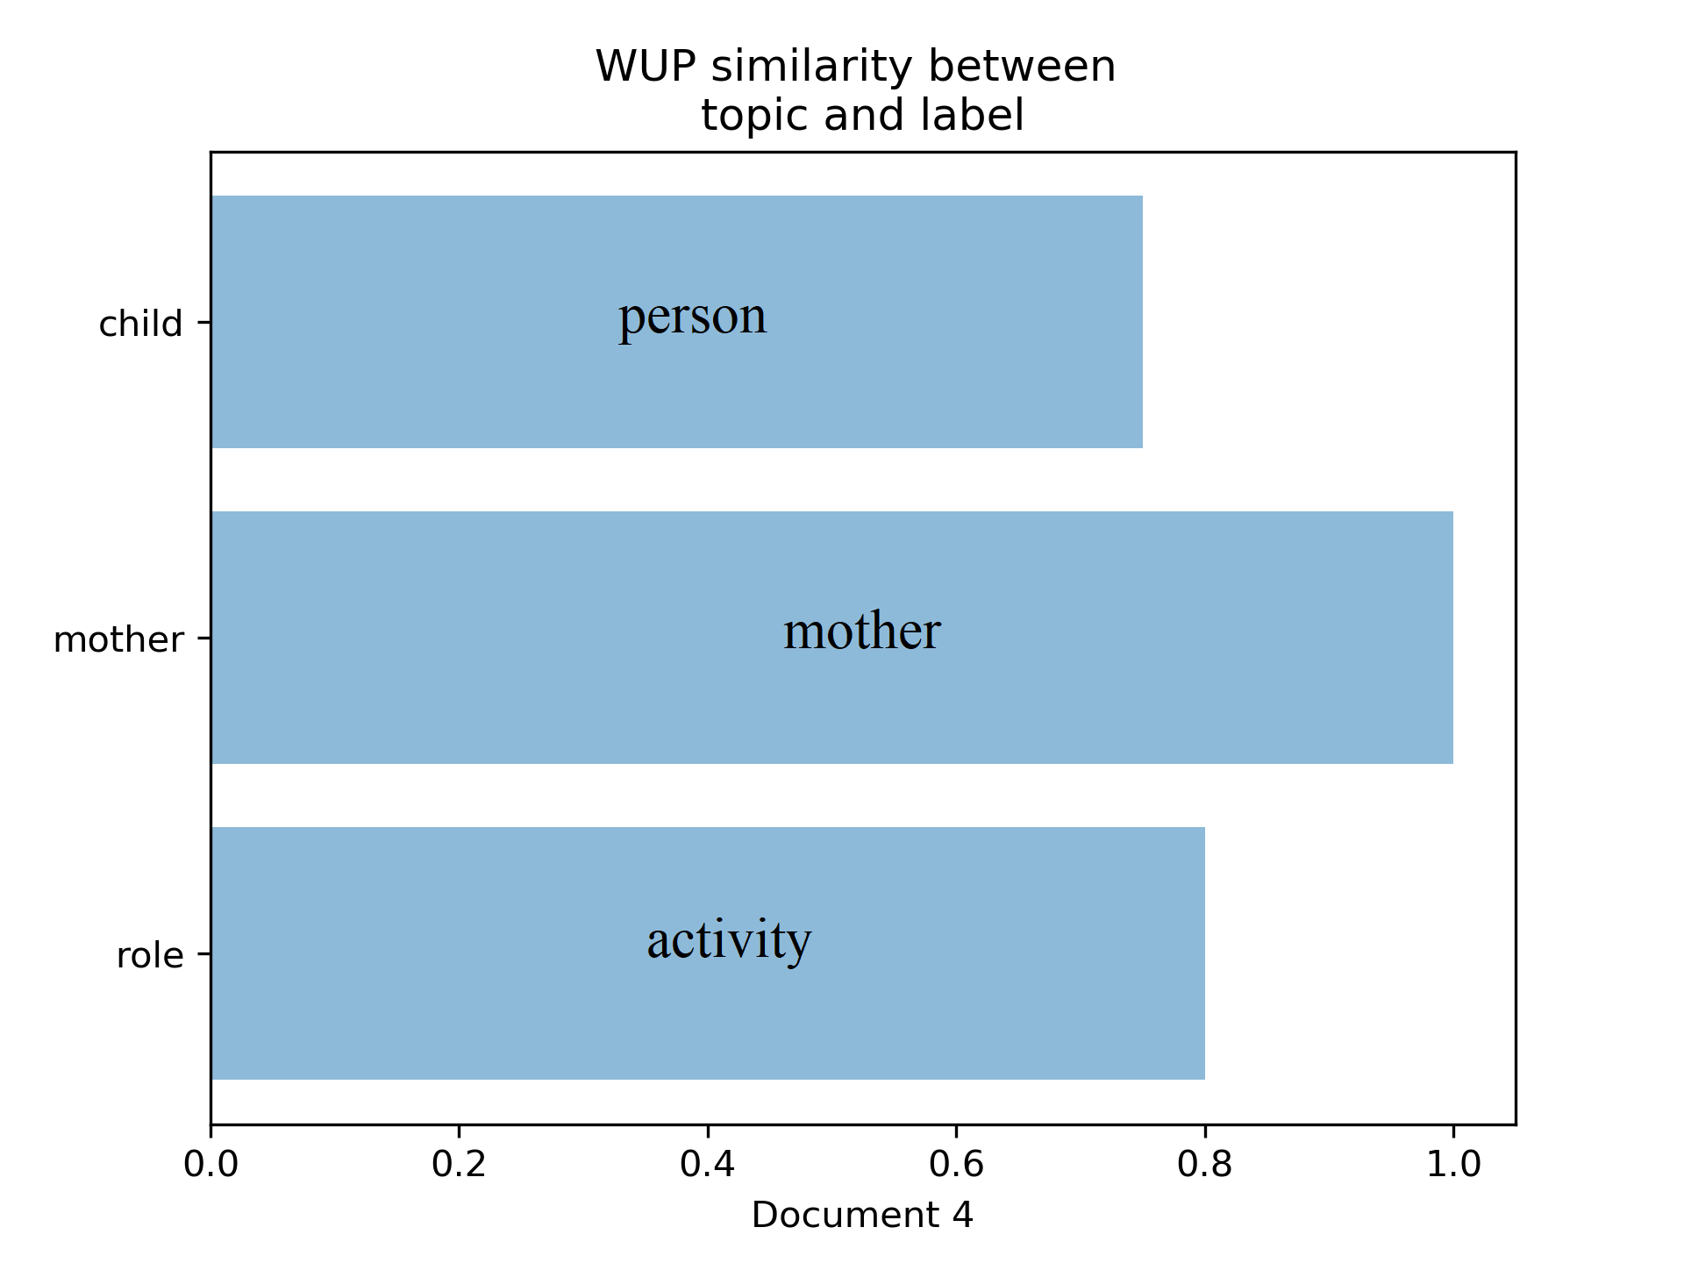
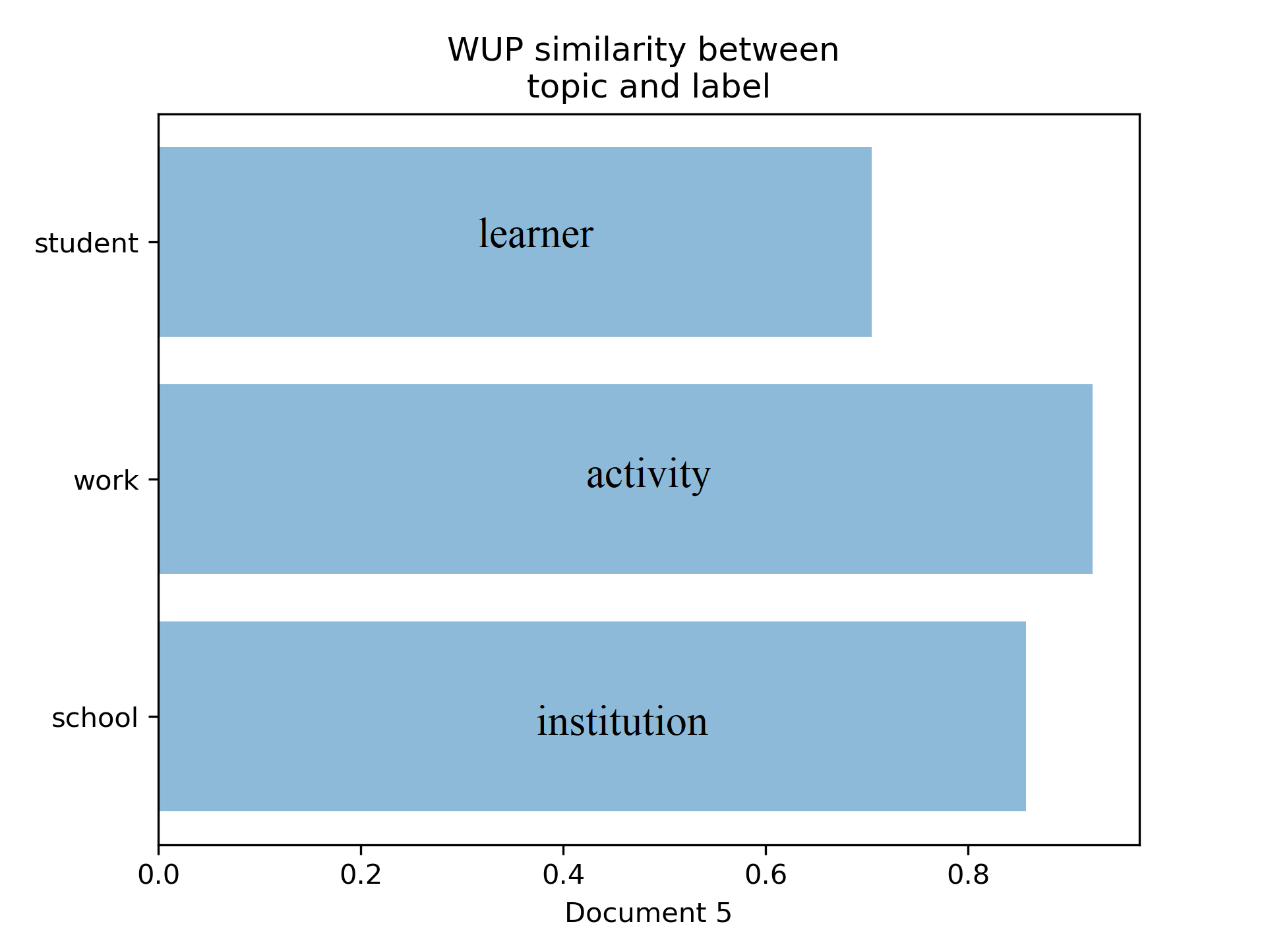
Result Analysis(Cont.)
Figure-7: WUP similarity between topic and label

Slide 19
Contribution
Model selection through mapping.
Give a new approach of labeling with WordNet and WUP similarity.
Give a glimpse of documents intuitive meaning.

Slide 20
Future Work
We have done this experiment on short document having word count approximate 200. In future we will do this for large data set.

Slide 21
Github Repository
https://github.com/Sourav-Hasan/topic-modeling-for-generic-labeling

Slide 22
Thanks

